Slide 1

Fake News Classification
Comparison of multiple classification models

Slide 2
Contents
Problem Statement
Data Collection
Data Cleaning
Exploratory Data Analysis
Data Preprocessing
Classification Models
Model Comparison and Evaluation

Slide 3

Problem Statement
This project aims to develop a machine learning system capable of distinguishing between real and fake news, thus aiding in maintaining the integrity of information dissemination.

Slide 4
Data Collection
The data used for this project is in CSV format, taken from Kaggle.
It has 72K rows and 3 columns – title, text, and label.
Label 1 means real news and 0 means fake news.

Slide 5
Data Cleaning
Convert label from numerical to categorical variable.
Drop the rows with null values, as they amount to less than 1% of the data.

Slide 6
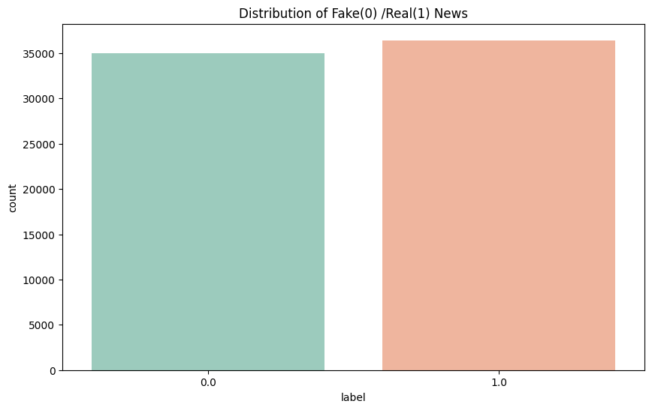
Exploratory Data Analysis
Distribution of Fake and Real News

Slide 7
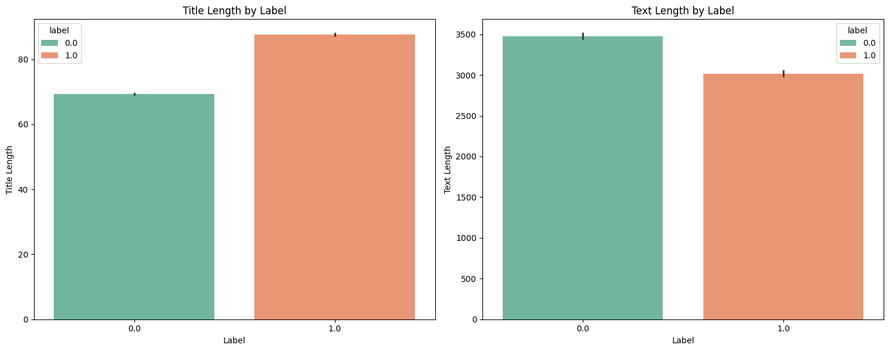
Exploratory Data Analysis
Title and Text length by label

Slide 8
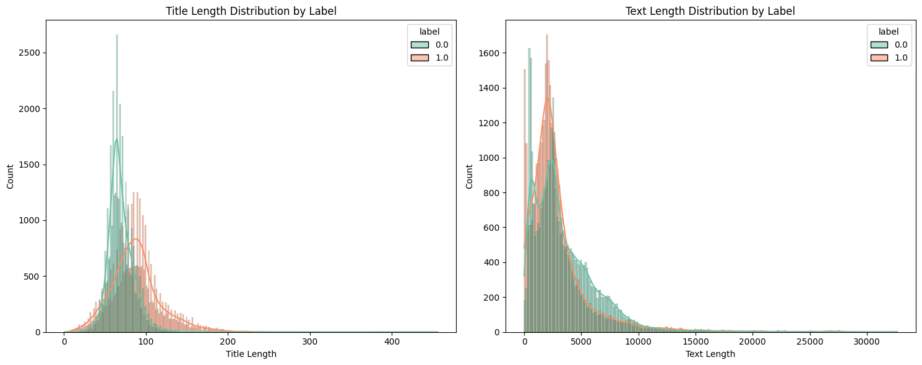
Exploratory Data Analysis
Histogram of Title and Text length by label

Slide 9
Data Preprocessing
Remove
Remove special characters from title and text.
Convert
Convert title and text into lowercase.
Split
Split the sentences into individual words.
Remove
Remove common stop words.
Reduce
Reduce words to their base forms.

Slide 10
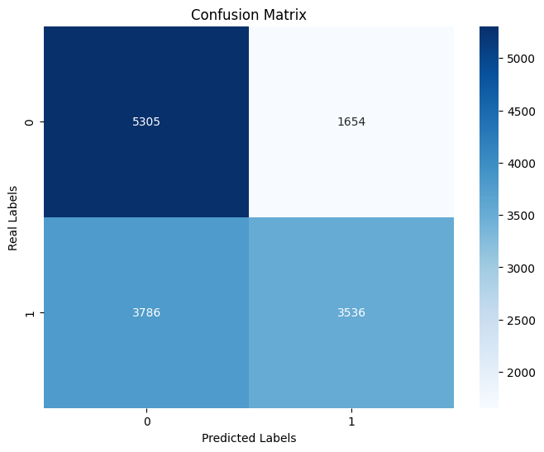
Logistic Regression
Test Accuracy: 62%

Slide 11
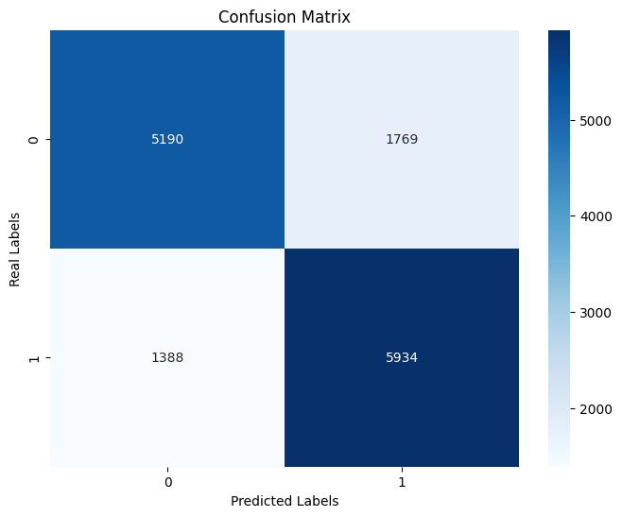
Decision Tree Classifier
Test Accuracy: 78%

Slide 12
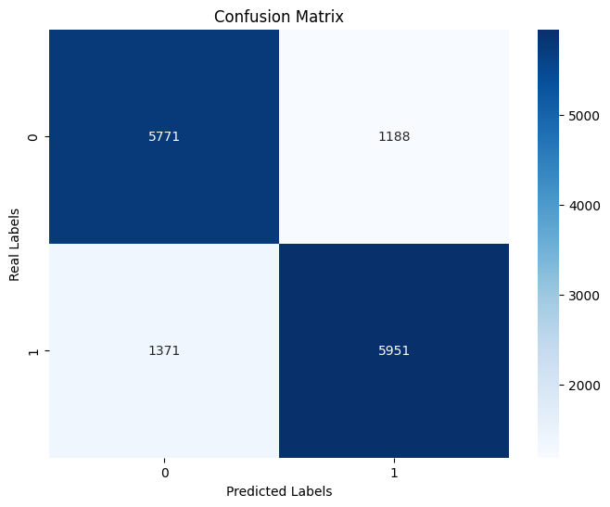
Random Forest Classifier
Test Accuracy: 82%

Slide 13

KNN Classifier
Test Accuracy: 63%

Slide 14
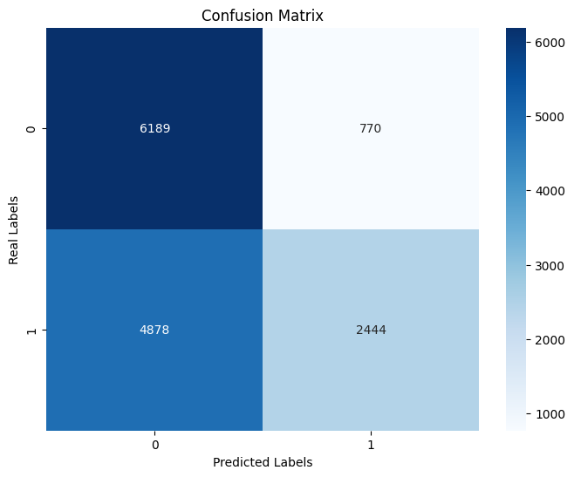
Naïve Bayes Classifier
Test Accuracy: 60%

Slide 15
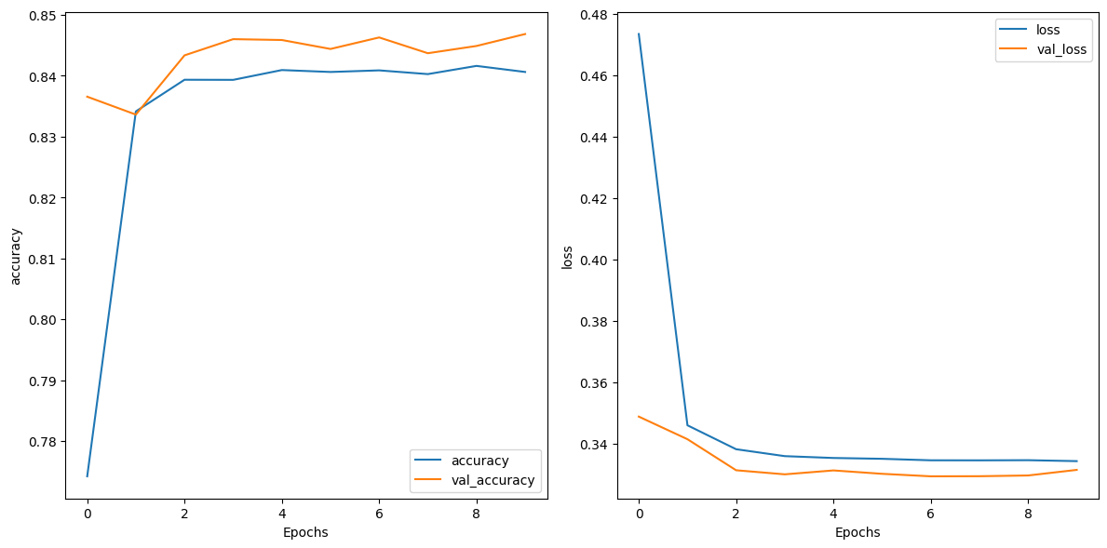
Neural Network
Test Accuracy: 85%

Slide 16
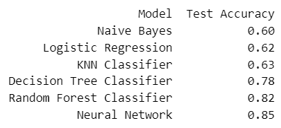
Model Comparison and Evaluation
Neural Network and Random Forest Classifier work best for this dataset.

